Slide 1
project stages

Slide 2
deploy project
making application accessible to internet
we have to choose one hosting service to deploy the project
we will use firebase hosting to deploy our project

Slide 3
steps to deploy
install firebase CLI globally
npm install -g firebase-tools

Slide 4
firebase login through firebase CLI

Slide 5
success message if everything is fine

Slide 6
intialise fire base in our project directory

Slide 7
as part of intialisation select the project to deploy

Slide 8
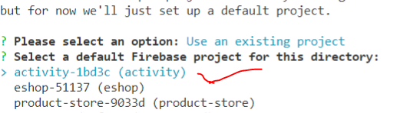
select project from existing directory

Slide 9
output directory

Slide 10
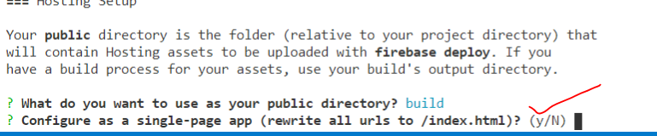
configure as single page application

Slide 11
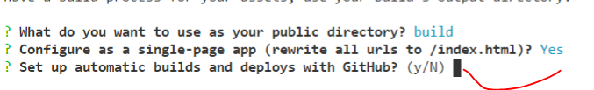
connect github for conteneous deployment

Slide 12
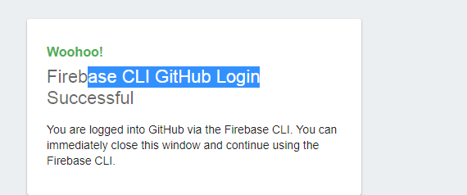
see the popup ->CLI to github connection success

Slide 13
select git repository

Slide 14
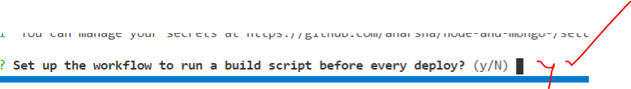
say yes for every deploy

Slide 15
select srcipt for each deployment

Slide 16
enter name git branch

Slide 17
end step of fire base init

Slide 18
after firebase init run the build script

Slide 19
after running build script for optimization ->deploy

Slide 20
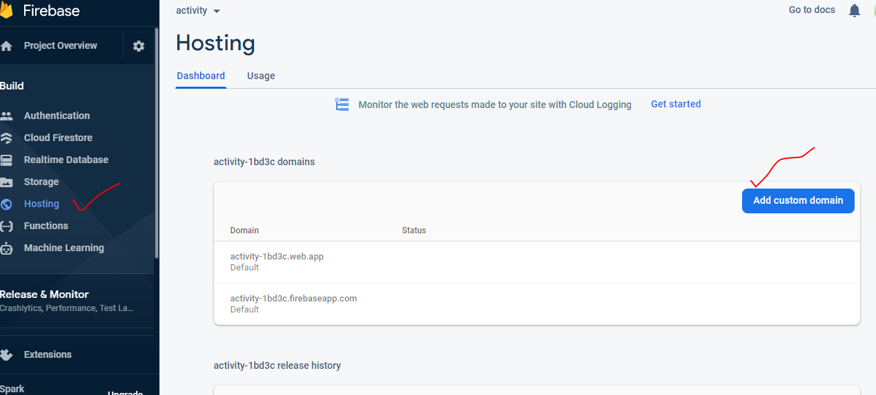
check in console fire base

Slide 21
redeploy
->modify the files
->build ->npm run build
->deploy-> firebase deploy
->refresh the page and observe changes after deploymenet

